Slide 1

STUDENT EXPENDITURE
Made by:-
Samarth (PPT Head)
Shubh (Data Head)
Shivesh(Reasearch Head)

Slide 2
INDEX
INTRODUCTION.
WHAT ARE STUDENT EXPENSES.
DIFFERENT CATEGORIES OF STUDENT EXPENSES.
ANALYSIS OF ALL THOSE EXPENSES.
MANAGEMENT OF ALL THE EXPENSES.
CONCLUSION.

Slide 3
INTRODUCTION
As a student progresses in their life from school to college, with higher education and responsibility, comes increased expenses. Whilst some student decide to stay away from their families for their higher studies, and other prefer to travel everyday to college, both require finances which acquire a major stake in college expenses.
Such costs that are apart from academic fees taken by the institute are called STUDENT EXPENDITURE. These payments are all the extra costs a student needs to pay to meet their daily requirements, for their survival as well as for their enrichment and leisure.

Slide 4
DIFFERENT CATEGORIES OF STUDENT EXPENSES.
Daily utilities
Bills
Food expenses
Stationery
Leisure
Transportation

Slide 5
WHAT ARE STUDENT EXPENSES.
Studies show that the majority of students worry about college expenses and costs. It’s no surprise because attending university or college is nothing short of expensive!
Education costs in the India are on the rise in recent years, but the expenses do not end there. Many students also worry more about living expenses than tuition fees as despite the fact that these expenses are taken care by their guardians, they still are advised to save them for good.
It is smart, therefore, to plan and anticipate your expenses way ahead of time. Setting a budget for everything while you attend a college or university can make your college journey a lot easier financially!

Slide 6

ANALYSIS OF ALL THOSE EXPENSES
Data-set source: Google forms survey
We surveyed mostly people from our college and our locality to avoid inter-area economic disparity
We had to make this on a short notice and thus, received data from very few individuals (21). Although grateful for your support, but it could have been better had it been at least 30 rows.
Using EDA (Exploratory Data Analysis) and Feature Engineering techniques we examined the following variables painstakingly.
Toiletries
Mob Recharge, Wi-Fi and Entertainment subscriptions
Rent for PG/Apartment, Electricity and Water Bill
Canteen Expenses and Leisure Expenses like Shopping

Slide 7
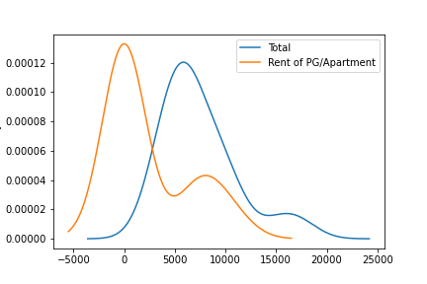
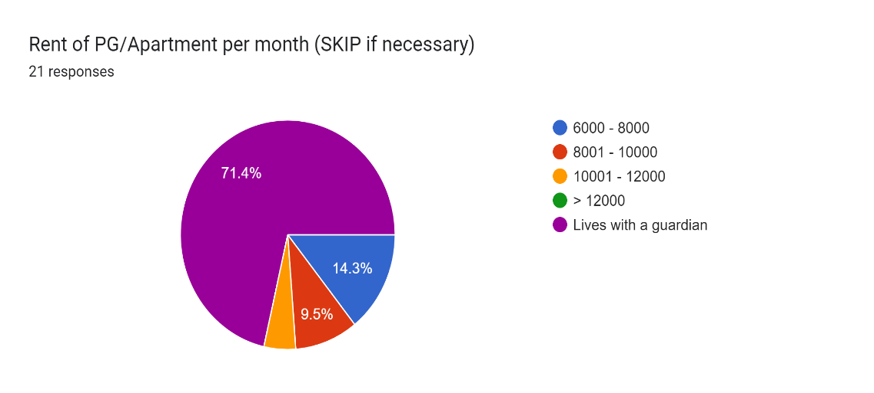
Major Variables like Total Expenses excluding RENT vs RENT for PG/Apartment
We can see that the generic KDE density curve shifts and lowers it later on the 12500 mark.
This shocking similarity of distributions only inferences that in a way the overall Total Expenses excluding RENT vs the RENT are equally significant for students like us.
This carries us forward to an equally convincing fact that a lot of us live with a guardian or in their own homes.

Slide 8
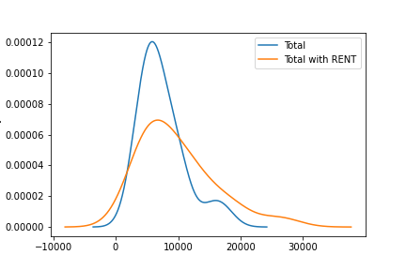
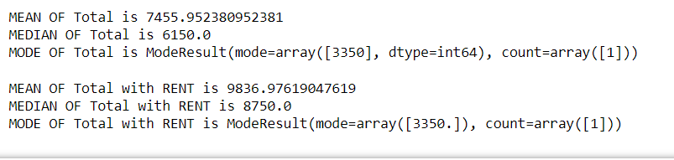
And you would be correct, the difference in their spread might even be seen from the moon
A very basic question like the difference in disparity and variance should be different then right?
DATA CAN BE VERY MISLEADING

Slide 9
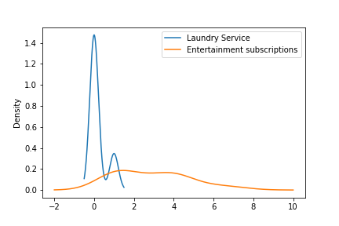
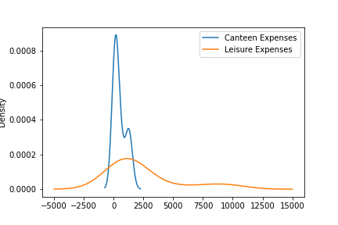
Leisure, Canteen, Laundry and Entertainment
For the very same reasons as seen in the previous slides we see why this distribution will be more of a bombshell.
And from the data we compiled we see the very same people that spend an extravagant amount of money in the above are the same people that live in their homes or with a guardian.

Slide 10
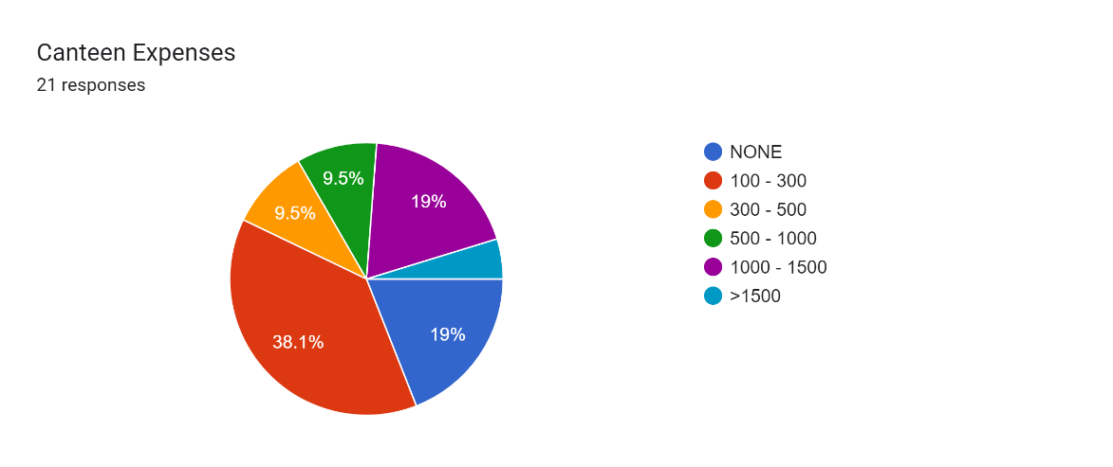
Supply of money creates demand – Economics 101
We can also notice from the graphs in the previous slides, that a huge amount of audience are willing to put their money on entertainment subscriptions and shopping , while a miniscule of the same assembly pay for services like of Laundry or wager in Canteen Services.
Although in the round sum it may add up to be quite similar, distribution of people of our age group in such varying interests concludes only one thing.
MORE SPECIFIC DATA IS NEEDED

Slide 11
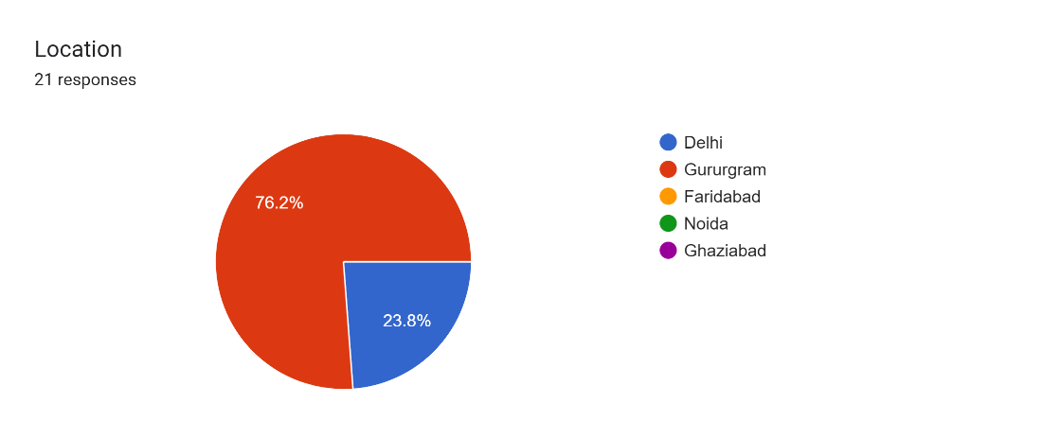
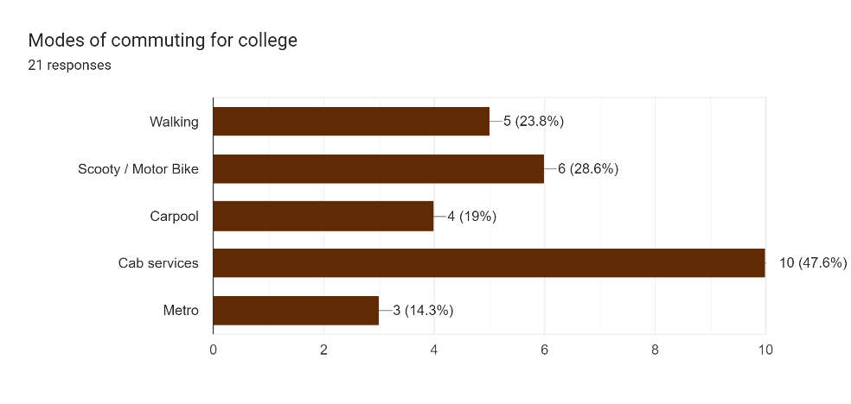
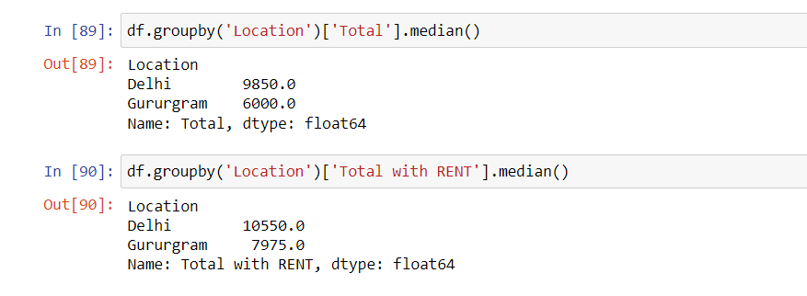
KEEP ME UP WITH ONE LAST INTERESTING CONCLUSION
People travelling from outside Gurugram tend to spend more money. So gold diggers from Gurgaon, get yourself a Delhite and you will be S-E-T. OR just rob them with the complimentary guns you have here.

Slide 12
MANAGEMENT OF ALL THE EXPENSES
1.Create a budget
Budgeting is the process of estimating in advance the expenses which are expected to be incurred in future. It entails preparing in detail, how much expense is expected in future. It is highly advisable for students to prepare a category wise budget like Food Budget, Telephone Budget, Travel Budget etc.
2. Keep a track of all your Expenses
It is very important for any person to know where the money is coming from and where it is going. Keeping a track of your expenses will help you identify your over-spend and wasteful spend areas. Once your over spend and wasteful spend areas have been identified – you should try reducing them.

Slide 13
3. Separate wants from Needs
One should classify all their expenses into expenses on necessities and expenses on luxuries. The necessity expenses have to be incurred in any case but the luxury expenses can be deferred depending on the cash position.
4. Resist Peer Pressure
A lot of spending nowadays is happening because of peer-pressure. Most of the people are buying phones, phone accessories, gaming tools not because they need it but because all their friends have it.
It is very important for students living on a fixed low budget to resist such peer pressure which will help them save out on a lot of cash.

Slide 14
5. Look for Discounts Online
The product sold online on e-commerce sites are most of the times cheaper than the products sold in stores. This is because most the physical stores have to pay a hefty rent for land which is not there for e-commerce stores.
6. Take advantage of Student Discounts
Many outlets like Starbucks, Dominoes, Apple etc offer additional discounts for Students. Money saved is money earned and students should try to make the maximum of such offers. Keep you student i-card handy as these stores will ask for your student identity card.

Slide 15
CONCLUSION
A college student first should learn the basics foundations of finances before starting his or her career. Financial planning is essential to be successful not only through college but also in life. Some financial keys that every college student should know are first to define your goals (Short term and long term goals), estimate your tolerance for risk and finally develop a plan for how to reach your goals.

Slide 16
Our social handles, source code and raw data-set
You may contact us through our linkedin profiles
Shubh Pundir: shb.pndr@gmail.com, Linkedin
Shivesh Kumar Dhiman: shiveshdhiman@gmail.com
Samarth Gupta: 2743samarth@gmail.com
GitHub link : https://github.com/ShubhPundir/Student-Expenditure-Analysis
THANK YOU

